Slide 1

Study of excavation positioning of roadheader based on visual measurement
我们毕业啦
其实是答辩的标题地方
Respondent
Cheng Chen
Advisor
Prof. Bai Yun
Notes:
----- 会议笔记(16-6-13 11:46) -----
大家好，我是来自12级的陈承。
我的题目是基于视觉量测的悬臂掘进机开挖定位技术研究。
指导老师是白云老师。

Slide 2
Abstract of My Research
Visual measurement is a construction positioning method developed in recent years. Combining visual measurements with on-site Guiyang subway construction, this research proposes an automatic positioning method of roadheader excavation, replacing human vision by machine vision, and changing the current situation in tunnel excavation. First, a laser beam emits from a distance to the tunnel face. Pictures taken by a camera set on the body of roadheader are analyzed digitally based on RGB system by building a computer model by using MATLAB. The model extracts spots’ centers. Then, based on mathematical analysis of digital image, model gives the decoupled eigenvalues of positional relationship between the actual position and the standard position of roadheader in three principal directions, so as to effectively guide the construction and implement automation. This paper also makes experiments to compare characteristics of single laser spot by RGB decomposition, test model’s accuracy in extracting image of laser beam, and use a similar model to analyze the impact of camera distortion in the actual work.

Slide 3
1. Background
2. Visual Model
3. Experiment
4. Conclusion
& Application
CONTANTS
Notes:
----- 会议笔记(16-6-13 11:46) -----
我要讲的内容分为四点：
研究背景，我设计的视觉模型，试验测试，拓展总结

Slide 4

Background
Notes:
----- 会议笔记(16-6-13 11:46) -----
首先，研究背景

Slide 5
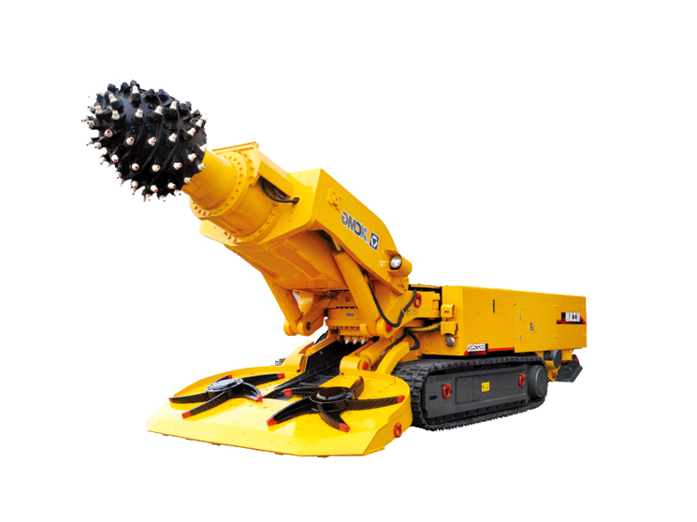
Background
Model
Experiment
Conclusion& Application
In southwest China, karst stratum is the majority. When it comes to tunnel excavation, traditional shield method is no longer appropriate because workers can not observe the condition ahead of the shield (for example, they can not observe the hole ahead). Therefore, roadheader becomes the main excavation method.
Some section of Guiyang Metro used roadheader for excavation and applied traditional human visual judgement associated with laser to excavate tunnel face.
Build-in problem of the current approach：
1.During underground excavation, severe dust influences workers’ judgement on the edge of tunnel face
2.When cutting tunnel floors, operator’s sight is obstructed by the machine
3.Construction quality highly relies on operators’ experience and proficiency.
Excavation around the edge of tunnel face becomes bottleneck, and has the “two-eight” effect — “it takes 80% of time for excavating the edge area which occupies 20% of tunnel face.
Improving the excavation technique of the edge of tunnel face is extremely urgent.
Notes:
----- 会议笔记(16-6-13 11:46) -----
西南地区，地层岩溶较为发育，隧道开挖存在困难，
目视激光不够有效
底板开挖视线受遮挡
效率低，改进边界附近的开挖技术，迫在眉睫
45s

Slide 6
Visual Model
Notes:
----- 会议笔记(16-6-13 11:46) -----
基于施工实际情况，我设计了一个视觉模型

Slide 7

Background
Model
Experiment
Conclusion& Application
Vision Measurement
Visual positioning is a positioning method developed in recent years. It refers to the technique that measures the objective’s position and posture with visual images obtained by camera.
-----Replace human vision by machine vision to make measurement and judgement.
Main Approach
Shoot objective → Image signal → Digital Signal → Picture Processing → Extract Features → Guide Construction
Notes:
----- 会议笔记(16-6-13 11:46) -----
视觉定位是近年发展起来的一种定位方法，主要是运用机器的视觉代替人的视觉。
然后得到图像信号，转换为数字信号后，进行图像的加工和处理，提取特征，从而指导施工。

Slide 8
Background
Model
Experiment
Conclusion& Application
Standard status
Shoot
Position Eigenvalue
Automatization
Position
/Posture
Digitization
Standardization/Analysis
Guide Construction
Step One
Step Two
Step Three
Step Four
Define the layout of laser beam, selection of laser, standard position and posture of camera and shooting parameters as the base line for the model calculation.
The core of the model is to compare actual images with the standard image and realize the judgement based on machine vision.
In practice, camera automatically shoot a picture and digitalize the picture in computer base on RGB system, transforming the picture into three pixel matrices. Then, build laser spot processing model, handle the matrices which are filled with noise points and extract the centers of laser spots.
Analysis of the centers of laser spots: fit curve with spots, conduct mathematical analysis of the fitted curve, quantify difference between actual fitted curve with the standard curve, quantify the difference between the actual camera position and posture with the standard status, and therefore find out difference between the actual roadheader position and posture with the standard status.
During excavation, keep comparing difference between actual roadheader position and posture with the standard status, and adjust the position and posture to guarantee that the construction carried out smoothly. After calculating the positional relation between roadheader and tunnel face, build local coordinate system, get the real-time position of cutting-head and realize automatic excavation.
Notes:
----- 会议笔记(16-6-13 11:46) -----
模型主要分为四个步骤：
1.首先，各个环节设立标准姿态，模型总体上均是通过与标准姿态的对比进行实时定位的。
2.拍照，处理照片，提取激光点。
3.理论分析，将对提取的几个激光点与标准激光点成像进行对比，得到相机与标准位置的差异。
4.通过旋转矩阵得到悬臂式掘进机的位姿，进而建立局部坐标系，得到截割头的实时位置，实现自动化定位。

Slide 9
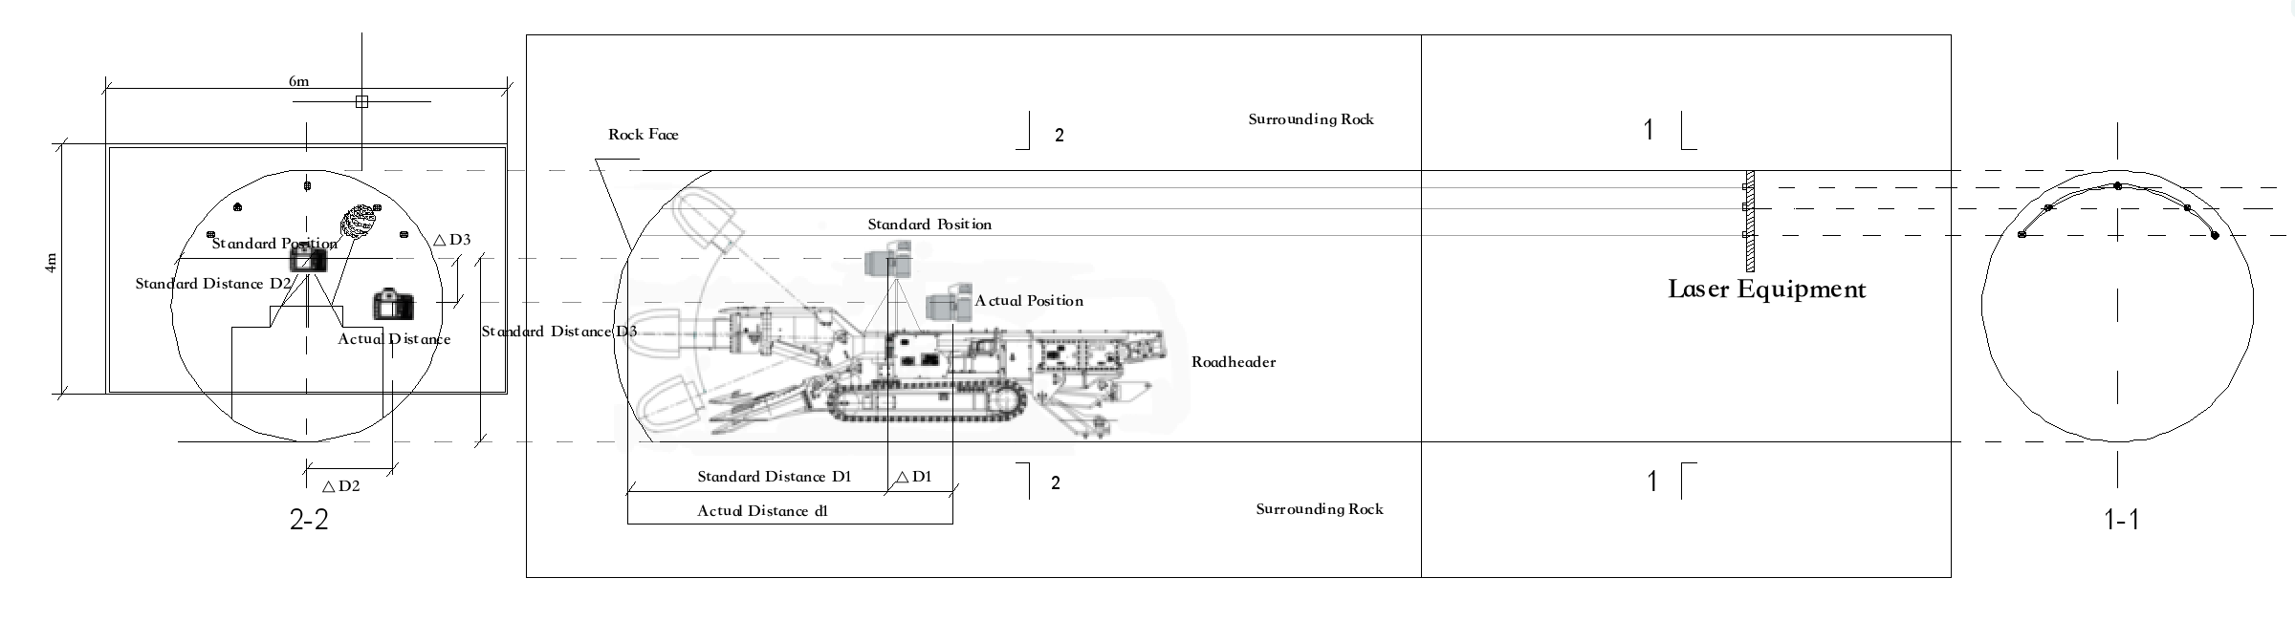
Background
Model
Experiment
Conclusion& Application
Standard status
Standard Position and Posture of Camera:
Position：Locates at the specific position of tunnel cross section and keep a specific distance with tunnel face;
Posture：Shooting orientation parallels the tunnel axis, horizontally placed.
Standard Position and Posture of Roadheader:
Position / Posture：Corresponds with the standard status of Camera；
Parameters of Camera：
Use appropriate ISO, etc. Keep parameters fixed during excavation；
Layout of Laser Beams and Selection：
Layout：Appropriate horizontal distance between laser beams and appropriate focal length
Selection：Red Laser，long wavelength，small scattering effects；
Position
/Posture
Step One
Notes:
----- 会议笔记(16-6-13 11:46) -----
首先，设立标准位姿：
这里主要关注相机，注意标准位姿时，D1,D2,D3距离是标准值。

Slide 10
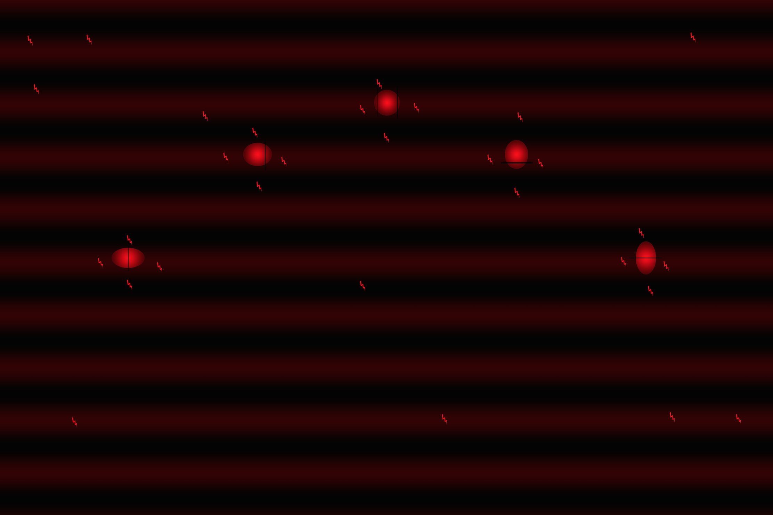
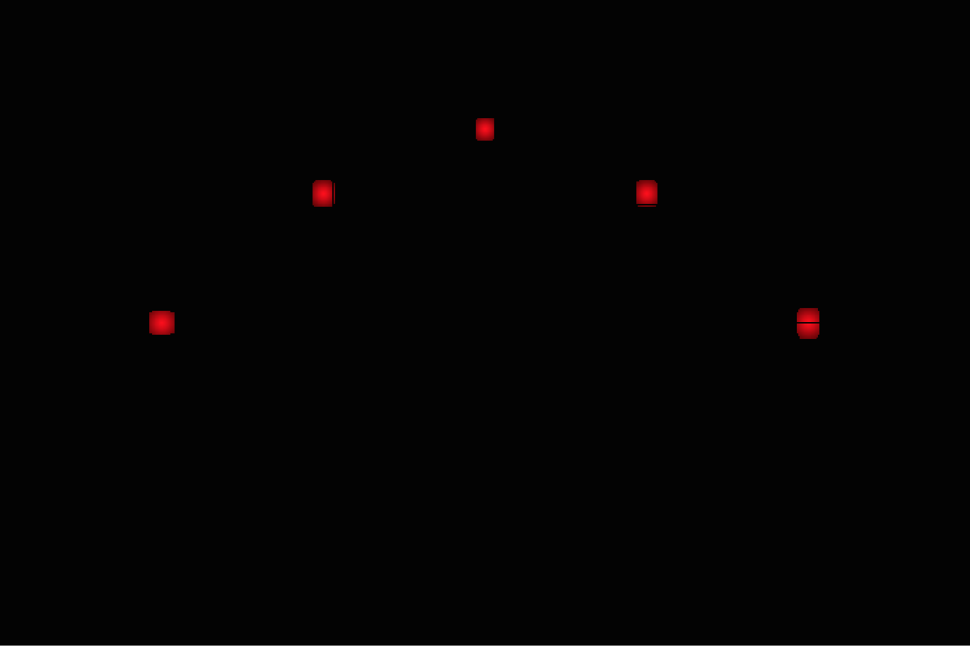
Background
Model
Experiment
Conclusion& Application
Step 1: Shoot a picture each time:
As shown in the picture, several oval laser spots with different eccentricity are arranged at the designed centers. Meanwhile, the picture simulates light scattering, irregular noisy points and gradual change of laser spot caused by environment. Size of the picture: 2000 pixel*3000 pixel
Shoot
Digitization
Step Two
Step 3: Extract centers of laser spots
Based on RGB system, calculate with weights and get centers of laser spots. Maximum error is 1.24 pixels, which less than 0.1% of the length of picture.
Step 2: Digitalize the picture and process to clear the noisy points
1.Under RGB system, use MATLAB to digitalize picture
2.Extract the “R” matrix
3.Process based on pixel threshold of element
4.Process based on pixel threshold of column
5.Process based on pixel threshold of column control algorithm, divide matrix into several column sections
6.Process based on pixel threshold of row
7.Process based on pixel threshold of row control algorithm, further divide each column section into several row sections
8.Process again based on pixel threshold of column
Notes:
----- 会议笔记(16-6-13 11:46) -----
照片中，提取光斑中心。
这个图是我模拟的充满噪点的图像，噪点认为是粉尘等引起。
提取后的结果如图
进行加权形心计算，提取中心，精度喜人。

Slide 11
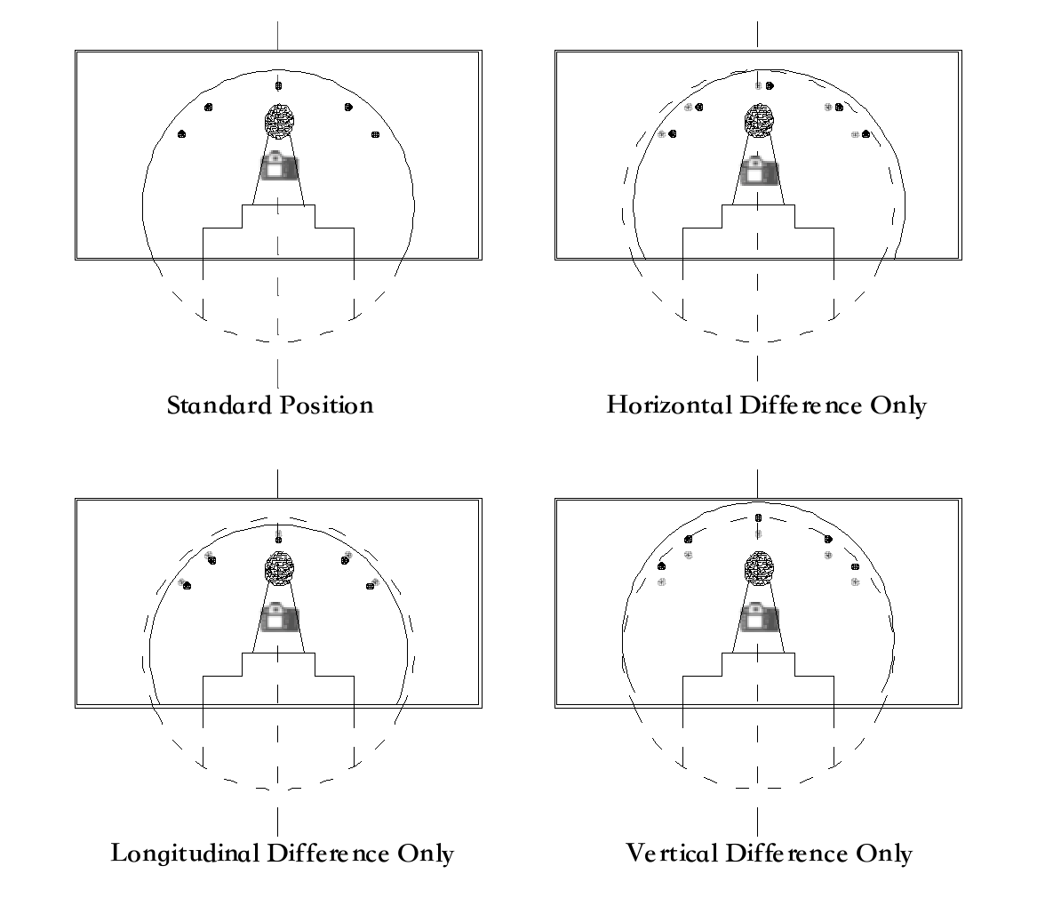
Background
Model
Experiment
Conclusion& Application
Position Eigenvalue
Step Three
Standardization/Analysis
Purpose：
As shown in Step One, when the camera is located in the standard position, it has a fixed position related to the tunnel face and the cross section, which is defined by D1, D2, D3.
In practice, the camera can always work under the standard posture, which can be controlled by sensors, but might not work under the standard position. In the three main orthogonal directions, the uncoupling difference with standard status is ΔD1，ΔD2，ΔD3，as shown in right figures.
By analyzing the curve-fitting from the centers of laser spots extracted in step two, extract the eigenvalues of the curve according to the shape and position of the fitted curve, and realize the accurate calculation of the ΔD1，ΔD2，ΔD3
Theoretical Analysis of Fitted Curve（KEY）
Under standard status (position and posture):
(1) For symmetrically arranged odd number “N” of laser spots, the polynomial expression of the curve fitted by using MATLAB built-in function “Polyfit” is uniquely exists and finite (Vandermonde determinant proves the linear independence).
(2)The polynomial is symmetrical (Method of undetermined coefficients; the highest degree of polynomial is an even number “n”, n≤N-1).
(3)The symmetric axis is uniquely exists and finite (Proof by contradiction).
In practice, the laser spots are not strictly symmetrical in layout. We need to prove that:
(1)For a n-degree symmetrical polynomial, the (n/2)st stagnation point is the symmetric axis. (Consider both real number and complex number).
(2)According to (1), after fitting the odd number “N” of laser spots by “Polyfit” function, the (n/2)st stagnation point of the derived function of the polynomial is the actual vertex of the fitted curve of the actual imaging points.
Notes:
----- 会议笔记(16-6-13 11:46) -----
模型采用MATLAB进行建模，运用了一些MATLAB自带函数的性质，需要据此进行证明。
对以下的一些结论我均给出了证明、
这里通过对图像的处理，将关于标准位置的三个正交方向非耦合的位置关系得出。

Slide 12
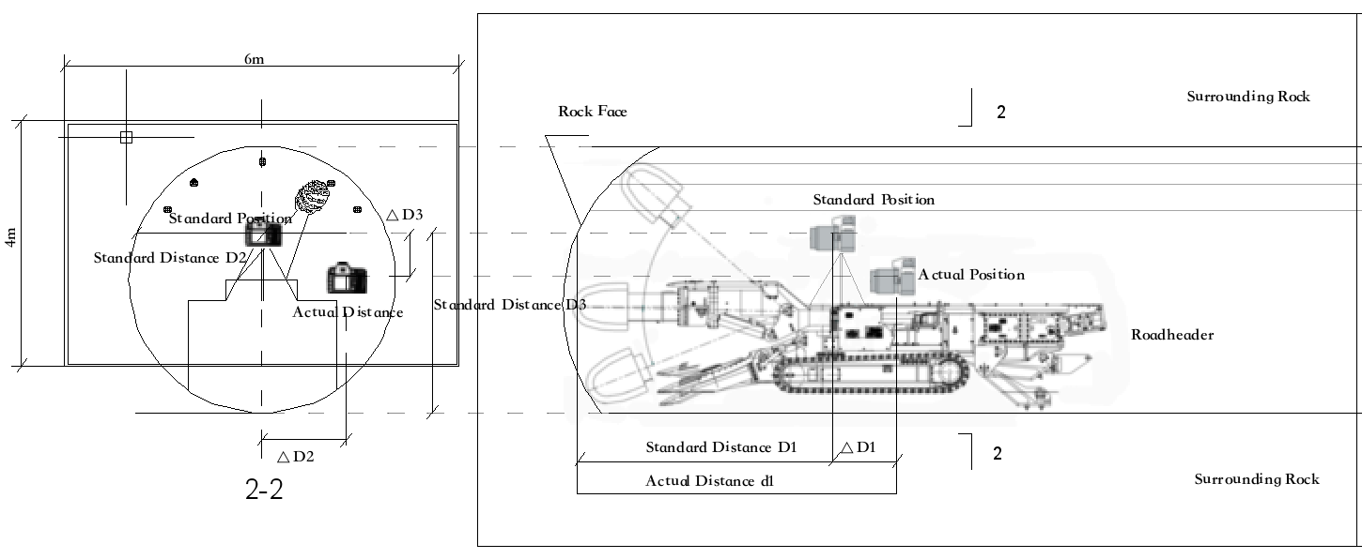
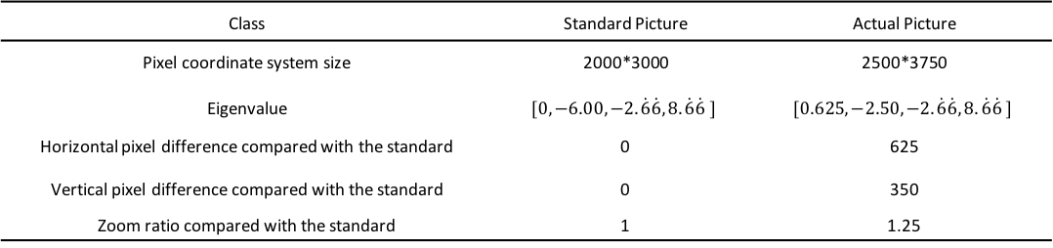
Background
Model
Experiment
Conclusion& Application
Class | Standard Picture | Actual Picture
Pixel coordinate system size | 2000*3000 | 2500*3750
Eigenvalue | $$[0,−6.00,−2.\dot{6}\dot{6},8.\dot{6}\dot{6} ]$$ | $$[0.625, −2.50,−2.\dot{6}\dot{6},8.\dot{6}\dot{6} ]$$
Horizontal pixel difference compared with the standard | 0 | 625
Vertical pixel difference compared with the standard | 0 | 350
Zoom ratio compared with the standard | 1 | 1.25
Position Eigenvalue
Standardization/Analysis
Implication:
If the picture shot from standard position has the relation with its digitalized image: 1 pixel corresponds to 2 millimeters. In this example, the digitalized image corresponds to a picture of 4m x 6m.
According to the eigenvalues in the table and correspondent pixel coordinate system, it means the actual position of camera is 0.25 times further than the standard distance to the tunnel face. And in the cross section, its position is 1.25 meters on the right sides of and 0.7 below the standard position.
It just takes one pictures to know the real-time position of the camera.
Given the position of camera, we could derive the position and posture of roadheader.
Step Three
1.Standard Spots Position
&Actual Spots Position
2.Translate Actual Coordinate System
Curve fitted in standard situations
Its eigenvalues are：
3.Zoom Actual Coordinate System
Fitted curve of actual position should use correspondent coefficients.
Notes:
----- 会议笔记(16-6-13 11:46) -----
这样的位置关系通过函数的特征值来体现，
提供了一个模型，直观来看，如果所摄标准画幅为4m*6m，则这些数据表明，相机实测位置比相机标准位置原理掌子面1.25倍，偏右1.25m，偏下0.7m。

Slide 13
Background
Model
Experiment
Conclusion& Application
Automatization
Given standard position of camera, because the bracket of camera and body of roadheader are rigid, we could calculate the position and posture of roadheader by using space rotation transformation according to the correspondent values of sensors on camera in the three main orthogonal directions.
Guide Construction
Step Four
Therefore, during excavation, the position and posture of roadheader compared with the standard status is:
And we could build local coordinate system based on roadheader. Because the nature of rigid body, we could get the real-time position of cutting-head. This can visualize the excavation and realize the automatic excavation.
Merely one shoot, then we know everything!
Notes:
----- 会议笔记(16-6-13 11:46) -----
再通过空间旋转变换矩阵，可以得到悬臂式掘进机位姿的六个参量。
----- 会议笔记(16-6-13 11:47) -----
建立局部坐标系，可以得到截割头的实时位置，可以实现施工开挖可视化，辅以智能处理，进一步实现自动化。

Slide 14
Experiment

Slide 15
Background
Model
Experiment
Conclusion& Application
Experiment Purpose
1. Explore the digitalization effectiveness under RGB for a single red laser spot in practice
2. Explore the accuracy of extracting centers of laser spots using visual models in practice
3. In a ratio similitude design experiment, the influence of distortion on the visual model
Experiment Equipment
Camera:
(1) Canon 1DX (2) Iphone 6plus
Lens:
(1) Wide-angle lens：EF 16-35mm F/2.8L II VSM
(2) Normal lens：EF 24-70mm F/2.8L II VSM
Laser:
M-33A660-250-G，MTO-Laser semiconductor laser，output power 250mW，wavelength 650nm, red light，spot pattern dot，focusing lens, variable focus.
Notes:
----- 会议笔记(16-6-13 11:46) -----
西南地区，地层岩溶较为发育，隧道开挖存在困难，
目视激光不够有效
底板开挖视线受遮挡
效率低，改进边界附近的开挖技术，迫在眉睫
45s

Slide 16
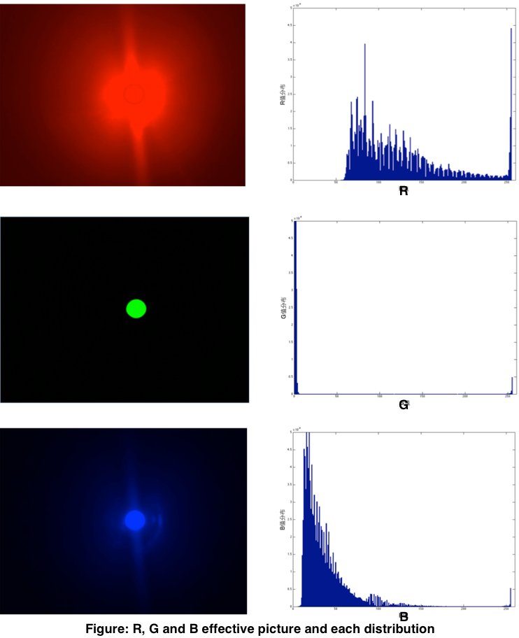
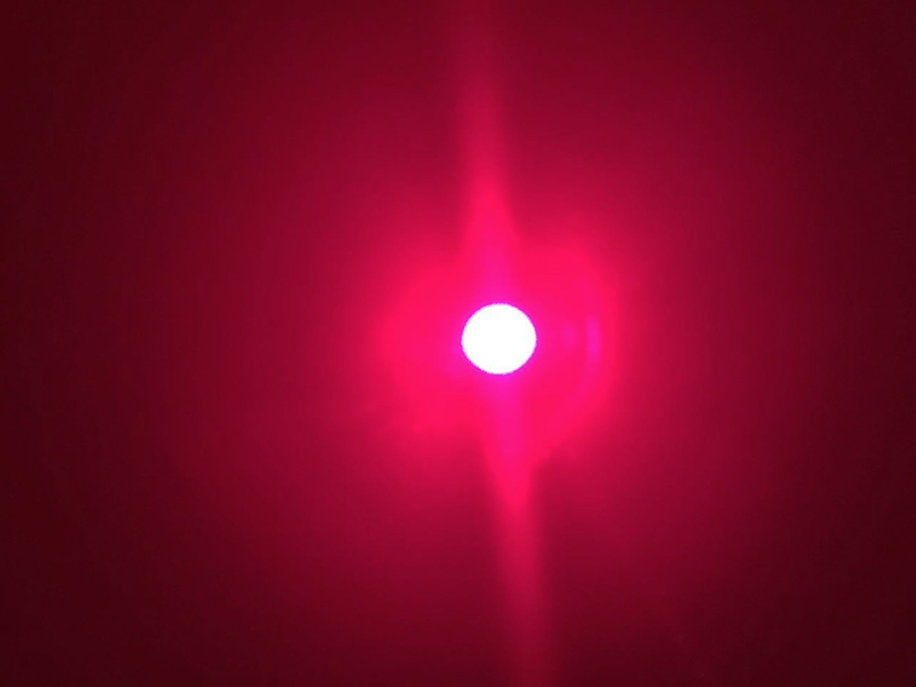
Background
Model
Experiment
Conclusion& Application
Single Spot
RGB Digitalization
Blooming phenomenon:
The red laser spot, appear to be white after shooting due to the slow shutter speed.
The reason that we still use “R” matrix to process picture:
The experiment does not simulate the dusty environment in real construction. Environmental noise light weaken the blooming phenomenon, bringing instability to model.
Notes:
----- 会议笔记(16-6-13 11:46) -----
首先，设立标准位姿：
这里主要关注相机，注意标准位姿时，D1,D2,D3距离是标准值。

Slide 17
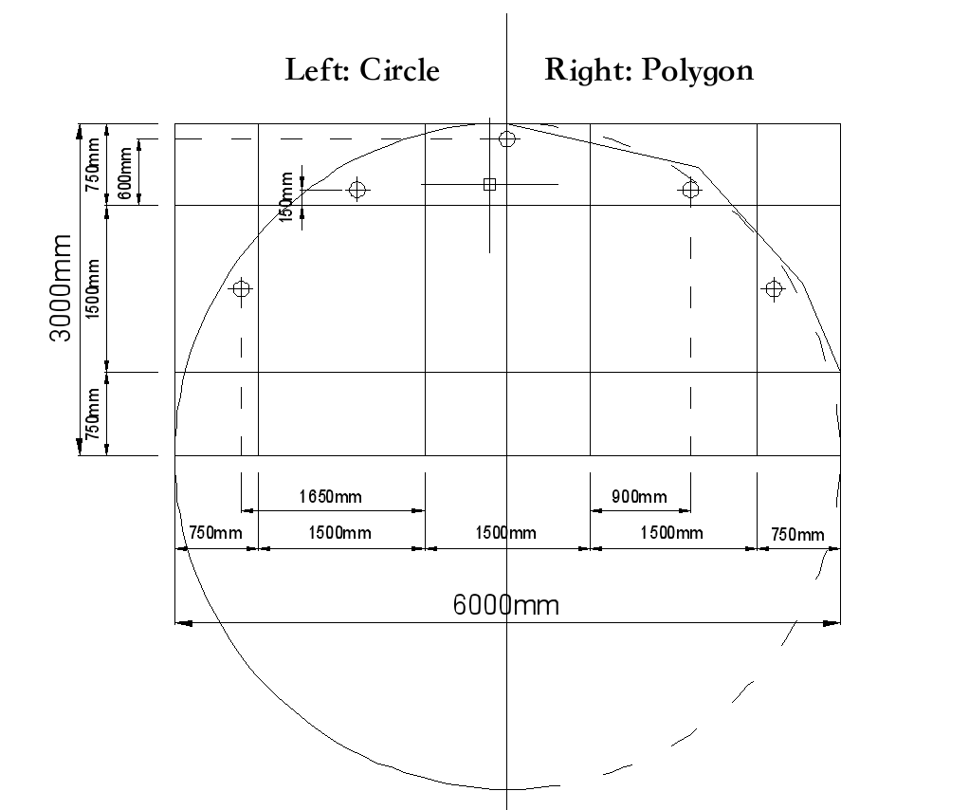
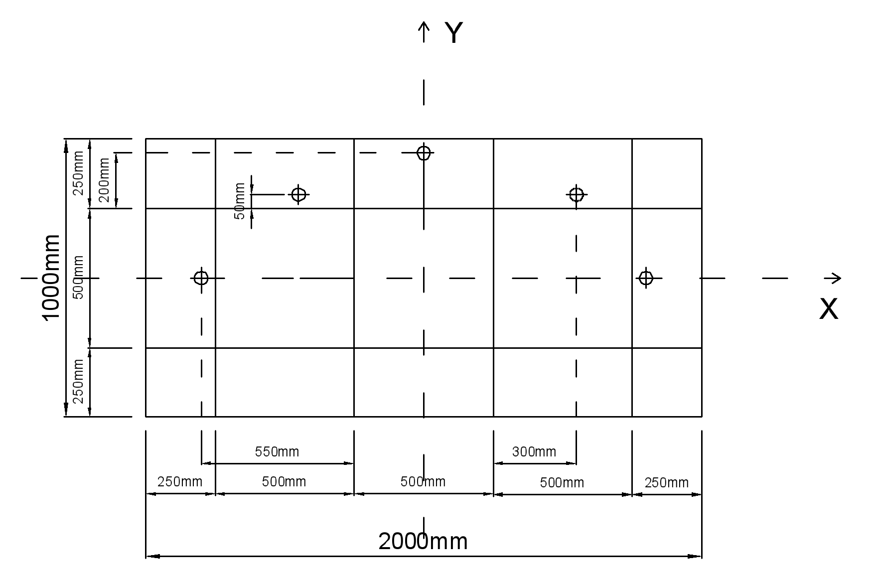
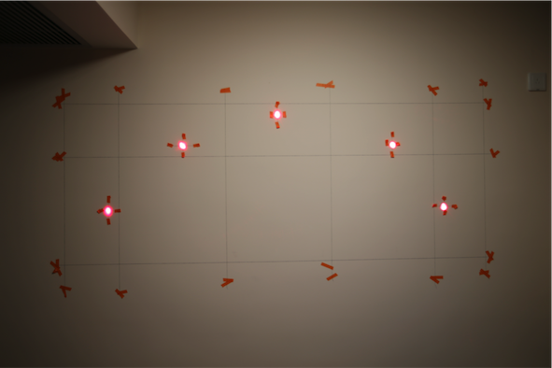
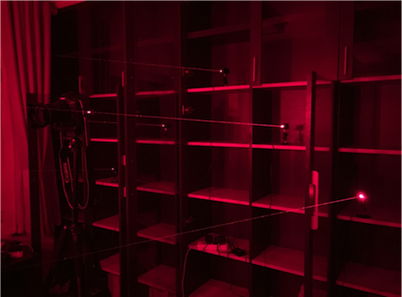
Background
Model
Experiment
Conclusion& Application
Figure 1: Engineering size (two type of tunnel section)
Laser Spot
Accuracy
Figure 2：Experimental size，use ratio of similitude 1：3
Figure 3: Coordinate system of experiment
Figure 4:
Experiment environment
Notes:
----- 会议笔记(16-6-13 11:46) -----
首先，设立标准位姿：
这里主要关注相机，注意标准位姿时，D1,D2,D3距离是标准值。

Slide 18
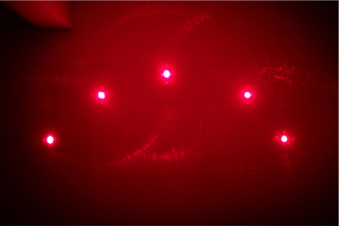
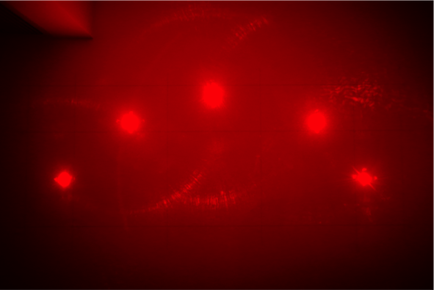
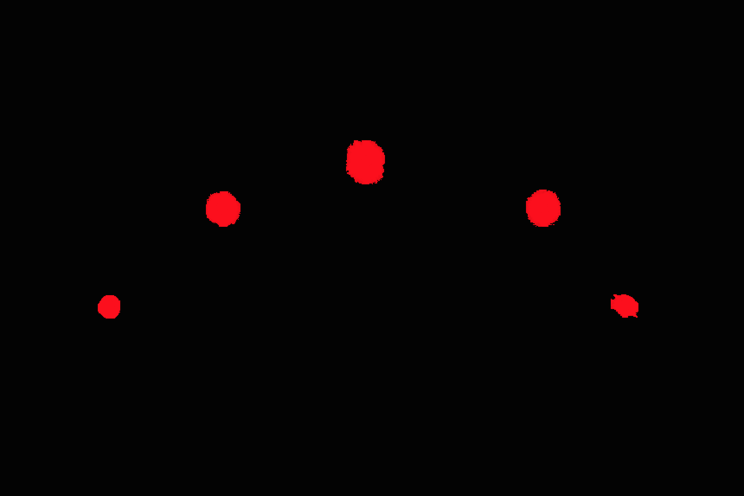
Background
Model
Experiment
Conclusion& Application
Laser Spot
Accuracy
Figure 5: An effect picture of shooting Laser spots (object distance: 1.7m)
Shooting Parameter: 5184 pixel×3456 pixel
ISO 5000， 24mm， 0.7EV， f/2.8，1/30
The experiment is designed to use high ISO and blooming phenomenon. (require higher performance)
Figure 6: Reconstruct picture based on R matrix of RGB digitalization
Figure 7: After model processing, the effect picture of remaining pixels for calculating centroid of each laser spot with weights
Figure 8: Expecting blooming phenomenon, calculate the centroids using G matrix which serve as the true centers of laser spots
Accuracy:
X direction: maximum absolute error is 5.24 pixels,
Y direction: maximum absolute error is 5.17 pixels,
Both less than 0.2% of length in correspondent directions.
Notes:
----- 会议笔记(16-6-13 11:46) -----
首先，设立标准位姿：
这里主要关注相机，注意标准位姿时，D1,D2,D3距离是标准值。

Slide 19
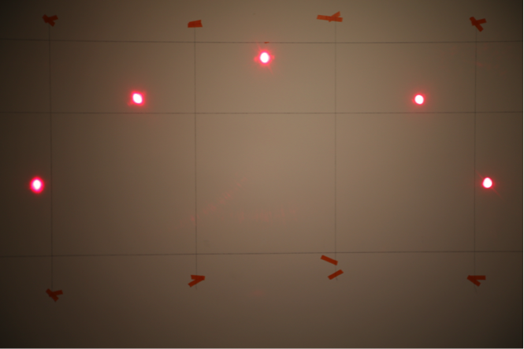
Background
Model
Experiment
Conclusion& Application
Laser Spot
Accuracy
Analysis of distortion：
According to grid, conduct interpolating calculation, analyze the distortion, and discover the pattern that distortion expands from the center and grows outwards.
· X direction: distortion on the side is 2 times as the error of visual model.
· Y direction: distortion on the side is 3 times as the error of visual model
Therefore, it is recommended to correct the distortion before processing the picture in visual model.
Notes:
----- 会议笔记(16-6-13 11:46) -----
首先，设立标准位姿：
这里主要关注相机，注意标准位姿时，D1,D2,D3距离是标准值。

Slide 20
Conclusion & Application

Slide 21
Background
Model
Experiment
Conclusion& Application
Non-horizontal, non-linear tunnel excavation
According to 《GB 50157-2013 Metro Design Specification》，based on the minimum curve radius of metro construction and maximum gradient, after quantifying the influence of distance on the visual model and compensating in accordance with standard status (position and posture), the model still applies.
A
Adaptability to all types of cross section
Because of the one-to-one correspondence in angle, the fitted curve of laser spots actually could realize the one-to-one correspondence with all types of tunnel cross section. It could generate actual profile in computer.
Therefore, the visual model is adaptable to all types of tunnel cross section.
Apart from that, because of the one-to-one correspondence in angle, the layout of laser beam could also be in any form. So, in practice, it is very flexible to change.
B
Big data and karst prediction
C
Visual positioning not only changes the approach of measurement, replacing human vision by machine vision, but also brings in a mass of data:
The data could be used to explore the correlation between engineering disaster (karst cave, etc.) and positions and postures of roadheader. It is a low cost way to realize this prediction and the accuracy would improve associated with the increase of dataset. No only it is different from traditional ways in engineering, but also protect the integrity and stability of the rock.

Slide 22
PPT模板下载：www.1ppt.com/moban/ 行业PPT模板：www.1ppt.com/hangye/
节日PPT模板：www.1ppt.com/jieri/ PPT素材下载：www.1ppt.com/sucai/
PPT背景图片：www.1ppt.com/beijing/ PPT图表下载：www.1ppt.com/tubiao/
优秀PPT下载：www.1ppt.com/xiazai/ PPT教程： www.1ppt.com/powerpoint/
Word教程： www.1ppt.com/word/ Excel教程：www.1ppt.com/excel/
资料下载：www.1ppt.com/ziliao/ PPT课件下载：www.1ppt.com/kejian/
范文下载：www.1ppt.com/fanwen/ 试卷下载：www.1ppt.com/shiti/
教案下载：www.1ppt.com/jiaoan/ PPT论坛：www.1ppt.cn
THANKS
Cheng Chen

